Slide 1
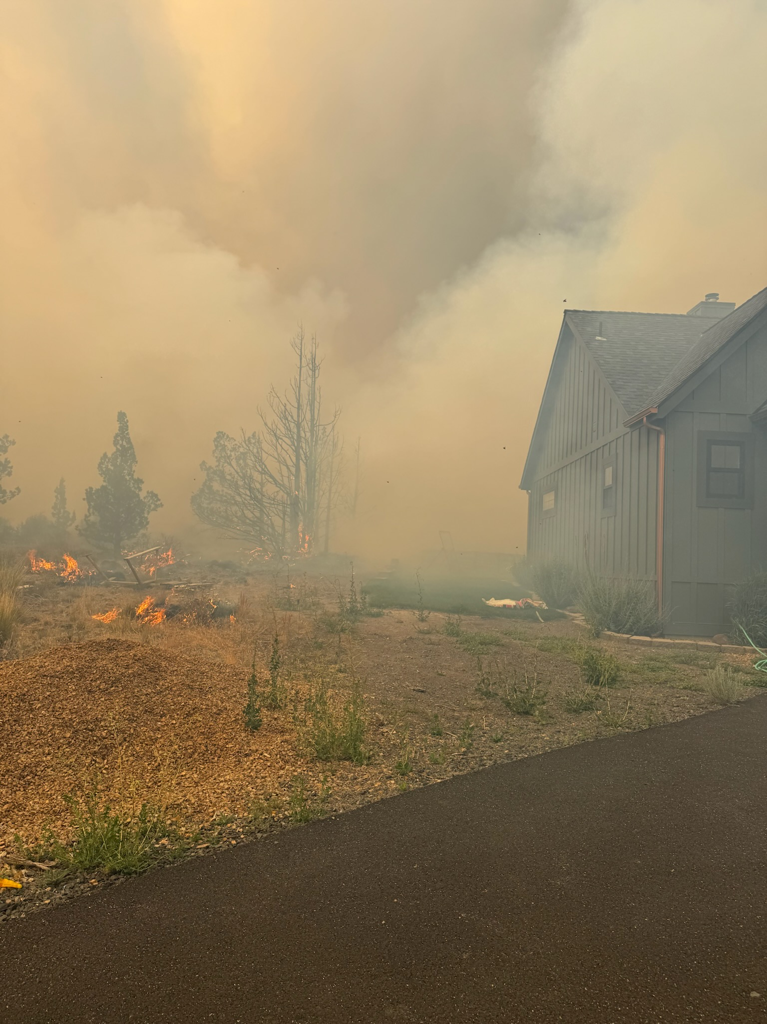

Slide 2
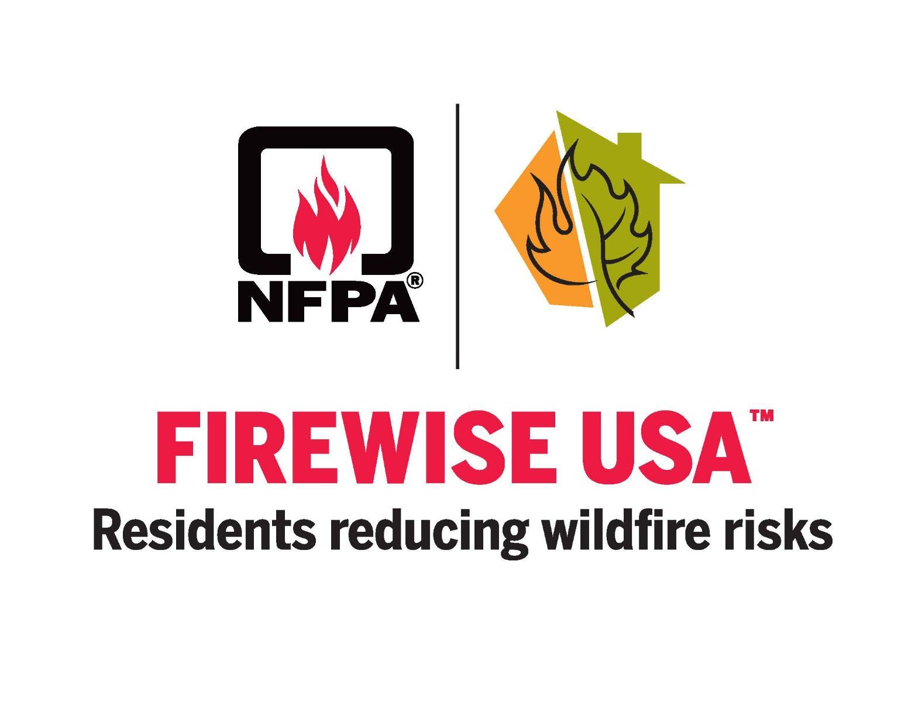
Notes:
What is Firewise?

Slide 3
Overview
What is Firewise USA
What is its Purpose
Requirements
Getting started

Slide 4
What is Firewise
Recognition Program that empowers communities to reduce wildfire risk in the Wildland Urban Interface

Slide 5
Purpose
Wildfire Risk is Shared Risk to Life and Property
Firewise is the Platform For Addressing this Risk
Building Community – Becoming Fire Adapted
Why is this important in La Pine?

Slide 6
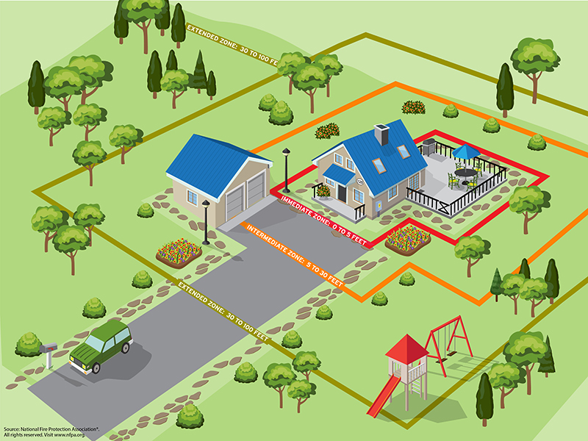

Slide 7
Requirements
8 Residences Minimum
Must Show Annual Investment
  Hours of labor
  Invoices from Contractors
Have an annual Firewise Day

Slide 8
Getting Started
Form a Firewise Committee
Pick a Resident Leader
Schedule Community Risk Assessment
Capture themes from Assessment in Document
Develop Action Plan

Slide 9
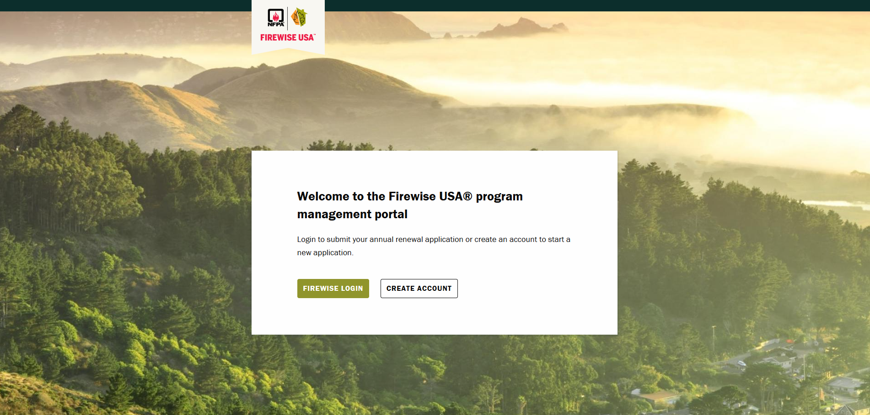
Getting Started

Slide 10
Getting Started
Complete 9 step application process in the Firewise Portal
Approval Recognition

Slide 11
Maintaining Recognition
Update Community Risk Assessment every 5 Years
Update Action Plan every 3 Years
Track Investment
Annual Firewise Day
Build Community (Relationships)

Slide 12
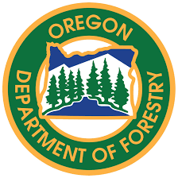
Questions?
Austin Reimer
Stewardship Forester
Oregon Department of Forestry
Central Oregon District
(541) 233-3160
austin.b.reimer@odf.oregon.gov

